Slide 1
Face Recognition Based
Attendance System
GUIDE
Ms Devi Nandhini V
DOMAIN
Computer Vision / Machine Learning
TEAM
A.Kannan - 95192309015
R.Muthu Bala - 95192309028
M.Santhosh - 95192309044
K.Akash - 95192309701
1

Slide 2
Domain
Artificial Intelligence & Data Science
Computer Vision
Face detection & alignment
Sub-domain: Computer Vision | Biometric Authentication
Applies deep-learning based feature encoding and classical machine-learning classification together (hybrid pipeline).
Deep Learning
Falls under image-based biometric identification — verifying identity purely from facial appearance, with no physical contact.
128-D facial embeddings
Directly relevant to institutional automation: attendance, access control, and identity verification.
Machine Learning
KNN identity classification
2

Slide 3
Abstract
Manual attendance methods such as roll calls and ID-card checks are slow and remain open to impersonation, since a photo ID can be verified visually even when the person presenting it is not its rightful owner. This project develops a facial-recognition based attendance system that identifies individuals directly from a live camera feed, removing the need for cards, tokens, or manual checks. Each face is detected, cropped, and converted into a compact numerical signature (a facial embedding) that stays stable across changes in lighting, head angle, and accessories such as glasses. A lightweight classifier then compares this signature against a stored database to confirm identity and log attendance automatically with a timestamp. The goal is a solution that is accurate, fast enough for real-time use, and practical to deploy at classroom or examination-hall entrances.
3
core stages: detect → encode → classify
128-D
facial embedding vector per face
0
physical contact or ID cards required
3

Slide 4
Objectives
1
Reliable face detection
2
Robust facial encoding
Detect faces accurately under normal classroom camera conditions before any recognition step runs.
Generate identity signatures that stay consistent despite lighting changes, head-tilt, and accessories like glasses or beards.
3
Lightweight classification
4
Automated attendance logging
Classify identities using a low-latency algorithm that supports adding new students without retraining from scratch.
Record recognized identities with a timestamp, and flag any unrecognized face instead of silently accepting it.
4

Slide 5
Literature Survey
Study
Approach
Key Finding
Bairagi et al.
Haar Cascade + LBPH, OpenCV
Cheap and fast, but degrades badly under uneven lighting or occlusion.
Kamil et al.
SVM with synthetic mask data
~82% recognition, 80% mask detection — tuned for one variation only.
Lateef & Kamil
YOLOv7 on live IP camera feeds
Over 90% accuracy, but needs heavy compute — unsuitable for low-cost edge devices.
Patel et al.
Dynamic preprocessing filters
Still breaks down with everyday glasses or dense facial hair.
Afiyanto et al.
CNN embeddings, varied lighting
Confirms uneven illumination sharply disrupts feature extraction.
5

Slide 6
Summary of Literature Survey
What the literature agrees on
Classical methods (Haar Cascade, LBPH) are fast and cheap, but fail under uneven lighting and occlusion.
THE RESEARCH GAP
No commonly used lightweight setup is evaluated against lighting change, head-pose variation, and facial accessories occurring at the same time — the exact combination a real classroom or exam hall produces. Heavier CNN pipelines that could handle this combination are too slow for smooth student entry.
Heavy deep-learning pipelines improve accuracy but add latency that is a poor fit for real-time entry checks.
Most systems are tuned for a single disruption (lighting OR pose OR accessories) — not all three together.
This project's direction:
Combine a lightweight detector with a deep-learning encoder and a fast classifier, so accuracy under combined real-world conditions does not come at the cost of response time.
6

Slide 7
Key Literature Reference
REFERENCE
Primary 2026 literature used for the review
JACK ET AL. (2026) • DISCOVER ARTIFICIAL INTELLIGENCE
“Development of a multi-facet facial recognition model for institutional attendance activities during examination scenario”
Kufre Esenowo Jack et al. • Discover Artificial Intelligence (2026) 6:746 • DOI: 10.1007/s44163-026-01474-y
Key evidence carried into our review
• Multi-facet conditions: lighting, head orientation and facial accessories.
• Haar Cascade + ResNet-based 128-dimensional encoding + KNN achieved strong recognition performance.
• Reported video recognition accuracy: 99.29%; overall response time approximately 6.00 s.
• Important limitation: Haar detection can fail under extreme angles / low-contrast illumination.
13

Slide 8
Existing vs Proposed System
EXISTING SYSTEM
PROPOSED SYSTEM
Manual roll-call / ID-card / RFID checks
Face recognition based attendance
—
Vulnerable to candidate impersonation — an ID photo can be checked visually while the bearer is an imposter.
✓
Verifies the person's actual face, not a card — removing the impersonation loophole entirely.
—
Manual verification is slow and does not scale to large exam halls.
✓
Contactless and automatic: no queues, no tokens, no manual entry.
—
RFID / smart-card methods are contact-based and easily shared or misused by proxies.
✓
Facial embeddings stay stable across lighting change, head-tilt, and accessories like glasses.
—
No automatic, timestamped attendance record.
✓
Attendance is logged with a timestamp the moment a match is confirmed.
7

Slide 9
Block Diagram — Proposed System
Faces are detected frame-by-frame, converted into a 128-dimensional embedding, and compared against the stored student database. A confirmed match is logged automatically; an unmatched face is flagged instead of accepted.
Camera
Capture
Pre-processing
(Grayscale + Resize)
Face Detection
(Haar Cascade)
Facial Encoding
(ResNet, 128-D)
Identity Matching
(KNN Classifier)
Attendance Logging
(Timestamp + ID)
No match → Unknown Person Alert
8

Slide 10
Modules Description
1
Image Acquisition & Pre-processing
Captures frames from the camera and standardizes them — resizing and converting to grayscale to reduce noise before detection.
2
Face Detection
Locates face regions in each frame using a Haar Cascade classifier, then crops the detected region for the next stage.
3
Feature Extraction & Encoding
Aligns facial landmarks and converts the face into a 128-dimensional embedding vector using a ResNet-based model.
4
Identity Classification
Compares the new embedding against stored student embeddings using a distance-weighted KNN classifier.
5
Attendance Logging & Alerting
Logs a confirmed match with a timestamp and student ID; flags any unmatched face under an unknown-person alert.
9

Slide 11

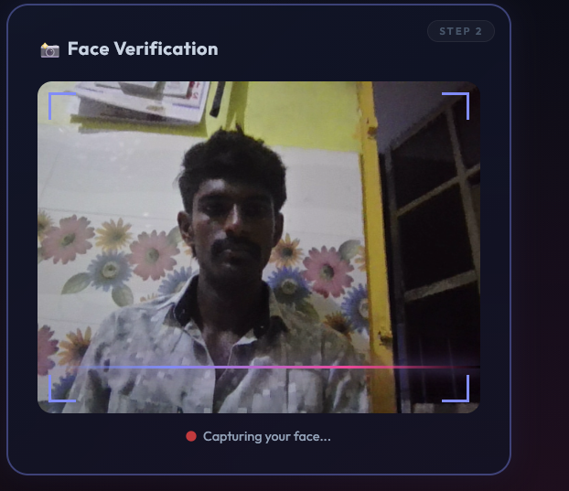
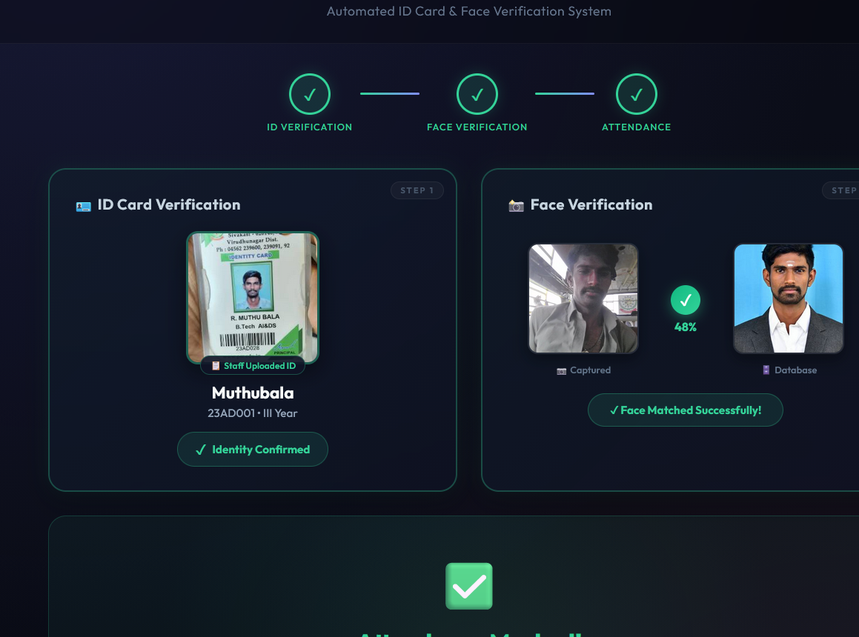
50% Modules Output
Completed so far: dataset collection, pre-processing, and face detection. Feature encoding and classification are in progress.
Dataset Collection
Pre-processing Output
Face Detection Output
IMAGE PLACEHOLDER
IMAGE PLACEHOLDER
IMAGE PLACEHOLDER
[Insert screenshot: sample captured images per student]
[Insert screenshot: grayscale / resized frames]
[Insert screenshot: bounding box around detected face]
10

Slide 12
THANK YOU
Smart Attendance System
using Face Recognition
AI + COMPUTER VISION
SECURE
CONTACTLESS

